Slide 1



Slide 2
AGENDA
Intros
Marcy intro/role
Hiring Process
New Employee Onboarding
  Roles
  Steps
  Forms
Next steps

Slide 3
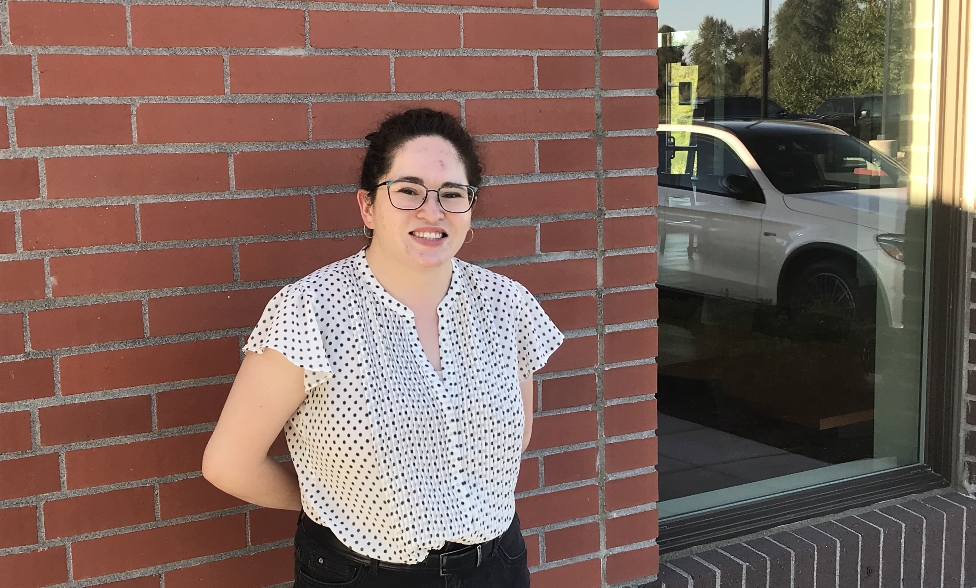
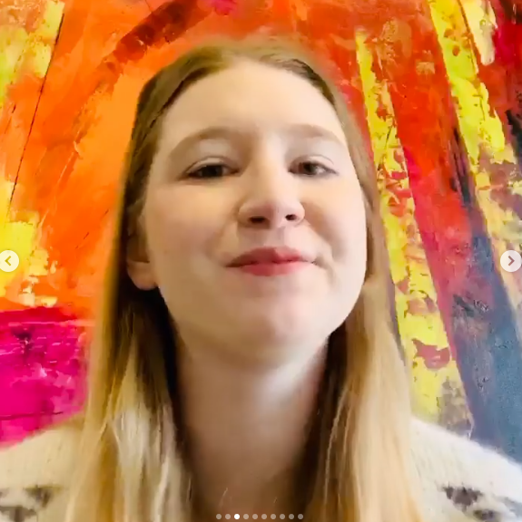
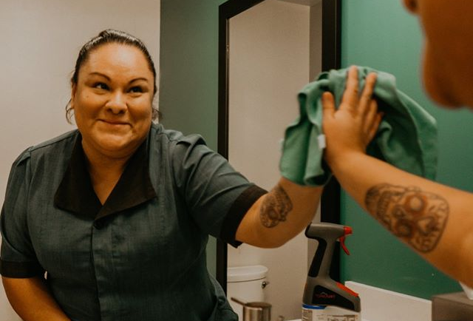
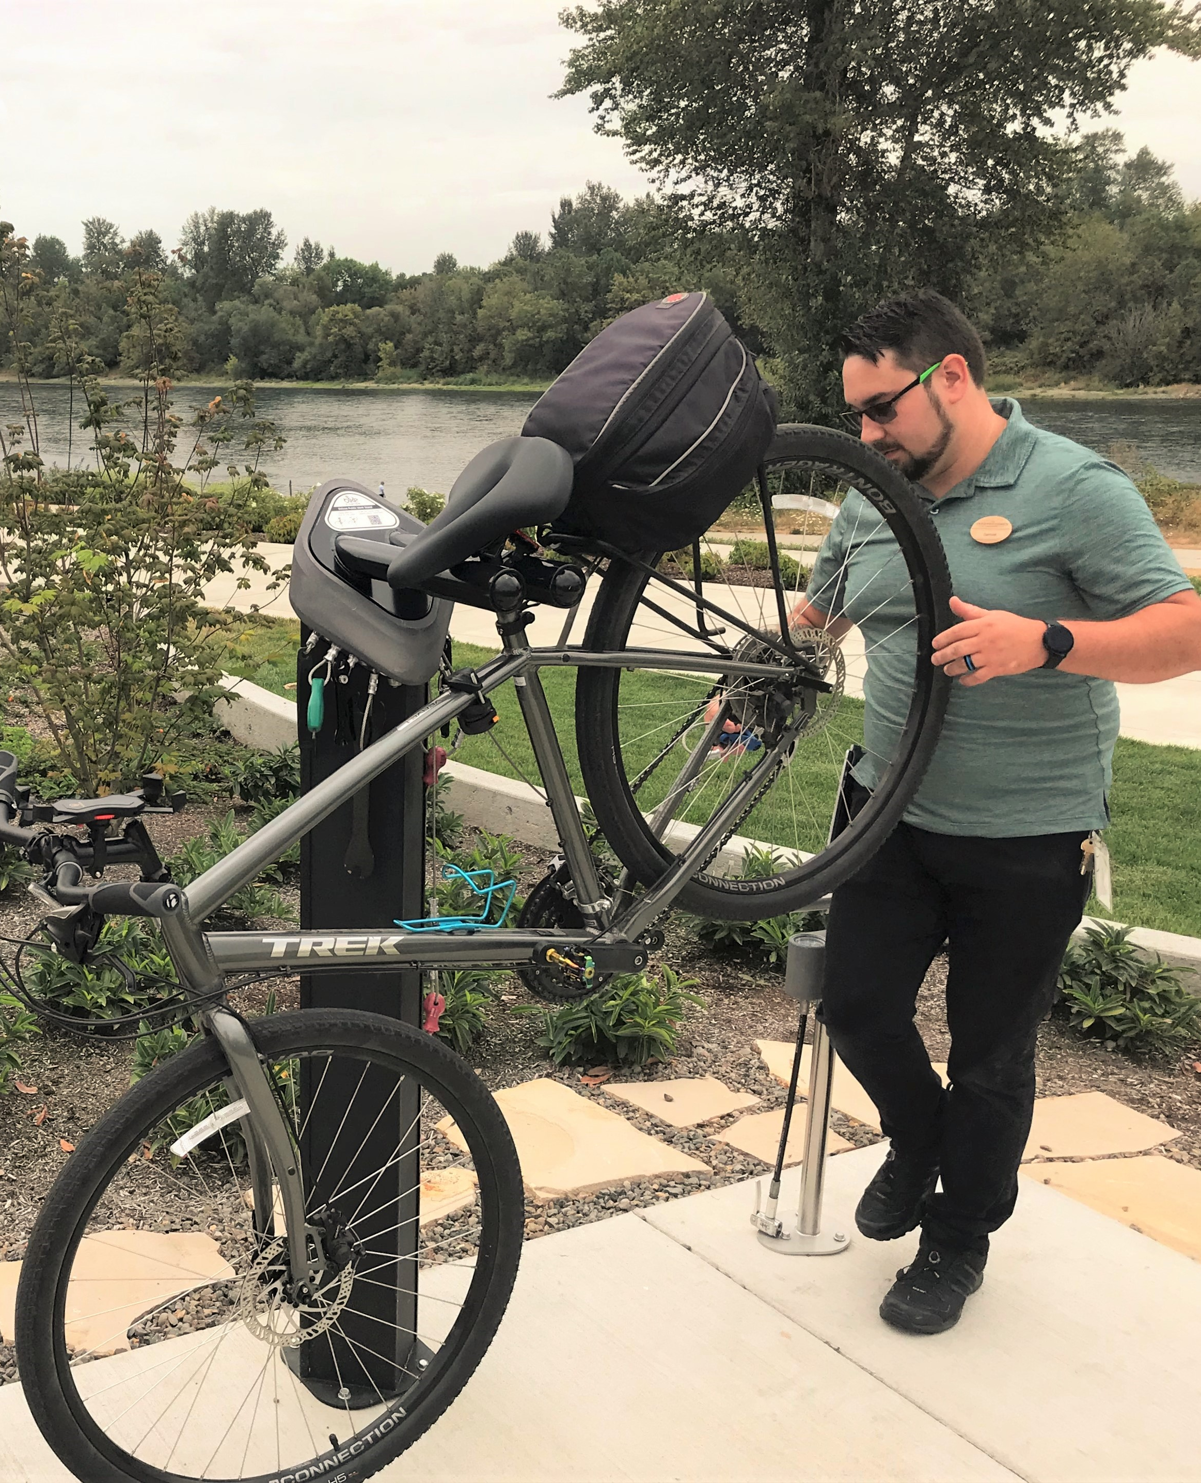
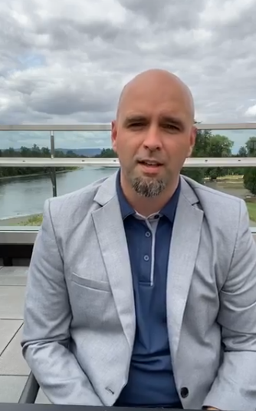
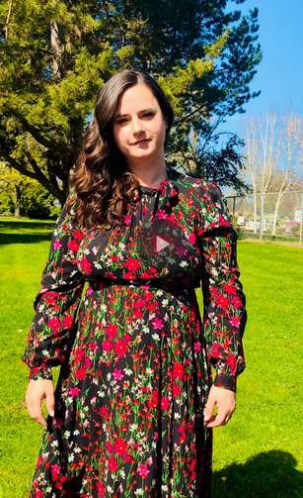
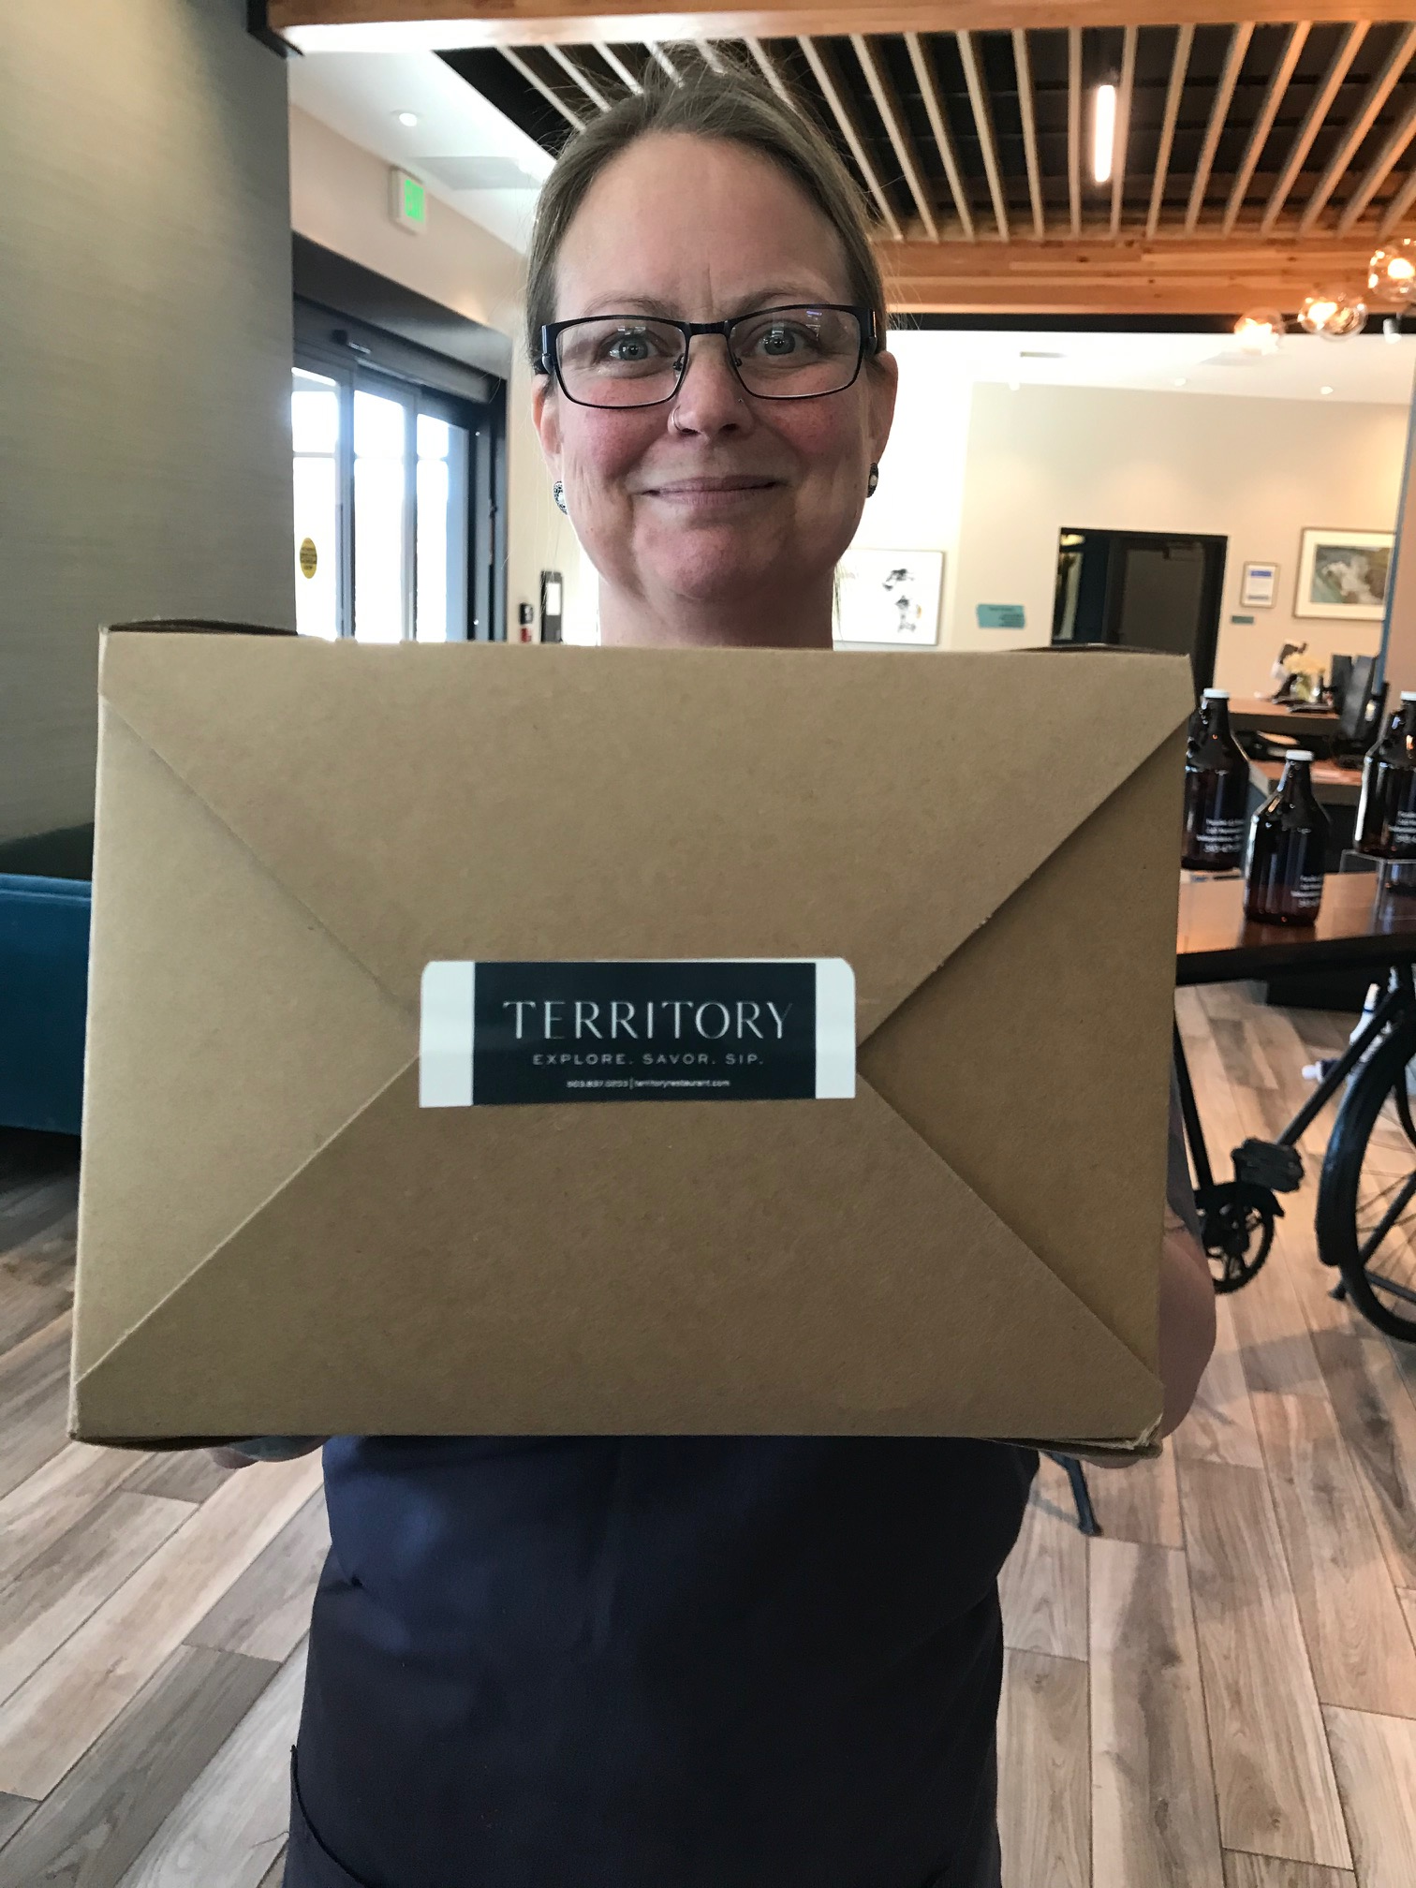
INTROS AND WARM UPS
Thank you for your leadership, endurance and buoyancy during challenging times!
Congratulations on steady gains and phenomenal customer response!
A-Team

Slide 4

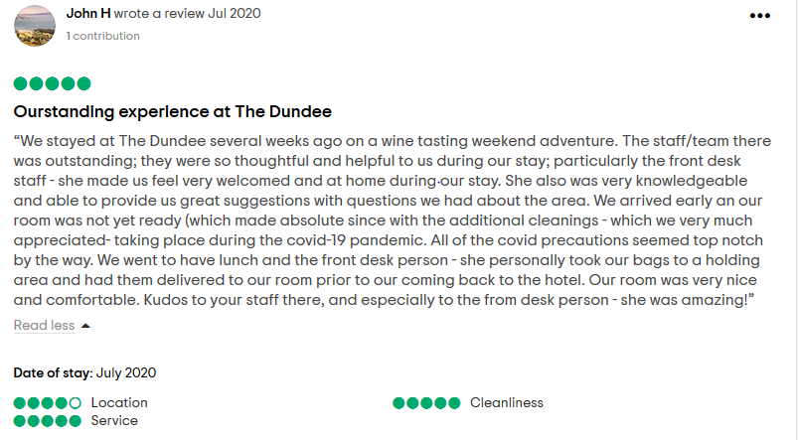

Slide 5
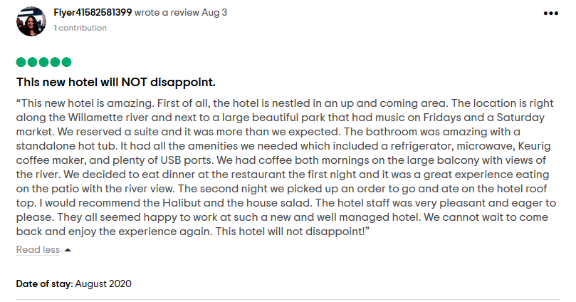

Slide 6
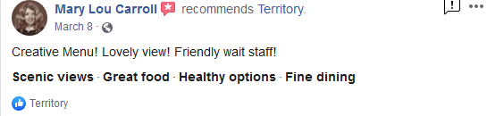
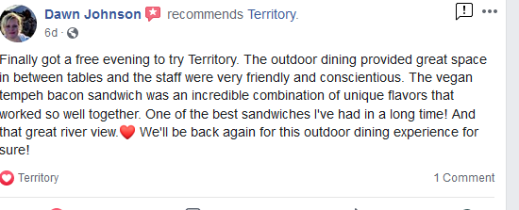
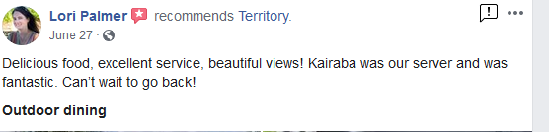
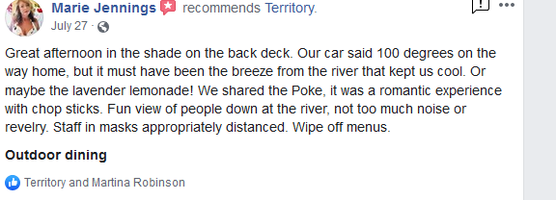

Slide 7

INTROS AND WARM UPS
1) One thing you are most proud of since February
2) A goal in the next month
3) Something you’ve learned or a way in which you’ve adapted from COVID that you will carry forward.
3) If your team had a mascot, what would it be.
4) When was the last time you laughed really hard?
5)Your most used Emoji
6) Your favorite dish to prepare

Slide 8


INTROS AND WARM UPS
Marcy Mee – Manager of HR and Staff Development
Marcy, integral part of HR and Payroll process
Rich management and HR experience, is a resource to you
May join for onboarding, may contact you for annual calendar reviews, etc.
Contact
  marcyEHG@gmail.com
  503-449-2436
Monday – Wednesday “Office Hours”
If emergency contact Mark or Sondra

Slide 9
INTROS AND WARM UPS
Marcy Mee – Manager of HR and Staff Development
Marcy, integral part of HR and Payroll process
Rich management and HR experience, is a resource to you
May join for onboarding, may contact you for annual calendar reviews, etc.
Contact
  marcyEHG@gmail.com
  503-449-2436
Monday – Wednesday “Office Hours”
If emergency contact Mark or Sondra

Slide 10

COMING UP……….
September 1st – 9:30 HR Management:
  Disciplinary
  Promotion
  Performance review, etc.
September 8th – 9:30 Focus on Handbook
Reminder – August 25th 10:30 401K
By 9/30/2020 complete audit/completion of employee jackets

Slide 11
FOUNDATIONS
If you are here now, you will be qualified to conduct the hiring and onboarding steps
Anybody not here, needs to go through a training with EHG before handling any aspects of hiring or onboarding
Employee jacket needs to be kept in locked file cabinet:
    Independence 2 locked drawers
    Territory 1 locked drawer/prep for 2
    Dundee 1 locked drawer
  Process outlined today will be used going forward for all new employees
Audit existing jackets and complete any missing pieces
Balancing crucial, concrete elements with need for flexibility

Slide 12


HIRING AND ONBOADING ROLES
Properties /Managers
Make hiring decisions and communicate with new employees
Collect all paperwork and enter employees in Prism
Store and securely maintain files
EHG (Mark, Sondra, Marcy)
Approval for new hire positions (during COVID)
Marcy point person for payroll and any onboarding issues
Marcy available for support for management and onboarding processes
Need to be brought in for any issues related to harassment, hostile work environment, discrimination
Xenium
Technical support for Prism –Danielle/Matt
Processing payroll
Provide regular management training
Employee relations concerns
Job Description Development
Compliance/Policy questions
Other Policy and Procedural Questions
Guidance for disciplinary/termination
Fremont/ Tokola
No longer involved in any hiring, onboarding or HR processes

Slide 13

HIRING PROCESS
EHG approves all new hires during COVID
  Email with position, PT/FT and proposed pay rate, reason for hire.
Recruitment
Collect and review applications – The application on file needs to be used
Conduct Interviews
References
    In lieu of background checks these are very important
    If at all possible, get a reference from a former supervisor
    References should be conducted by managers
    General reference questions in file
Prepare offer confirmation/notify EHG
Set start date!

Slide 14
HIRING DOS AND DONTS
Don’ts:
Ask questions, talk about, include info in your notes about:
  Race/ethnicity/national origin
  Sex/Gender
  Religion
  Citizenship
  Maiden Name
  Military Discharge
  Arrest Record/Criminal Record
  Age
  Marital/Relationship status
  Sexual Orientation
  Disability
  Workers’ Comp History
  Salary History
Ask for, or take a picture of the applicant
Say “off the record”, then ask a question
Encourage/try to get the applicant to say negative things about current/former company or boss
Dos
Deflect/return to job duties if any of the Don’ts are brought up
Use application on file
Use the general questions and references on file
Get assistance from EHG, fellow managers, Xenium as needed
Be warm and friendly, put them at ease
Remain objective
Maintain confidentiality
Track questions and schedule while interviewing
Be present in the interview – not on phone, etc.
If relevant, do a skills demonstration
Conduct background checks

Slide 15


ONBOARDING PROCESS
Employee’s 1st day:
  Employee offer confirmation that employee signs
  Employee checklist
  Employee jacket - Keep on file
  Prism entry
  Forms provided to the employee (electronic or paper)
  Culture and information shared
  Any specific licenses that need to be “on file” (OLCC, food handlers, etc.)
Regular electronic access to files

Slide 16
FORMS….

